Slide 1
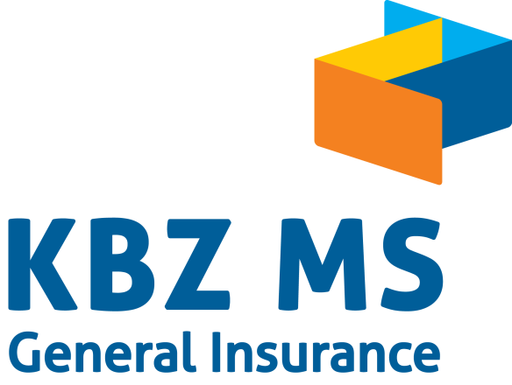

Slide 2

Motor Portfolio Analysis
Data range (aPR 2019 – Mar 2020)
Prepared by Operational Efficiency Department

Slide 3

Background
Toyota is popular brand in KBZ MS.
Hypothesis: Loss reduction by putting priority on what kind of brand/ models KBZ MS is accepting.
Which brands/models should KBZ MS be careful when Accepting policy?

Slide 4
Overall Data and LOSS RATIO (Apr 2019 – Mar 2020)
Data for Motor Brands
Data for Toyota Model
Loss Ratio - 81%
No of Policies –
21,337
Written Premium
– MMK 6,841 Million
No of Claims –
5,592
Claim Paid Amount – MMK 5,559 Million
Loss Ratio - 59%
No of Policies –
8,524
Written Premium
– MMK 2,038 Million
No of Claims –
2,212
Claim Paid Amount – MMK 1,200 Million

Slide 5
Comparison of data in term of Written Premium, Claim amount, No of policies and No of claims For Motor Brands
While Toyota is the most popular brand in KBZ MS, we are also getting profit for Mitsubishi, Kia and Hyundai.
Although KBZ MS is selling more policies (double/ triple of No of claims), Claim paid amount is higher than written premium income for some of the brands (Nissan, and Suzuki) .

Slide 6
Comparison of data in term of Written Premium, Claim Paid amount, No of policies and No of claims For TOYOTA MODEL
After the detail data of popular brand, TOYOTA, was broken downed, we found out that top 10 models are making profits.
*In order to show the data more precisely, “other” models of Toyota brand has been removed from the graphs.

Slide 7
Comparison Of Claim Paid Amount And Loss Ratio (Motor Brands)
Sunlong is the one who has the highest loss ratio followed by Suzuki, Nissan and Scania.
There is no motor brand which loss ration is under 50%. The smallest loss ratio is 52% which is the loss ration of Hino.
Loss ratio of Toyota Brand is 59%.
Loss amount= Frequency x Severity
Loss Ratio (Above 100%)
Motor Brands | Claim Paid Amount | Loss Ratio
Sunlong | MMK 265 Million | 137%
Suzuki | MMK 272 Million | 121%
Nissan | MMK 665 Million | 116%
SCANIA | MMK 409 Million | 106%
* Breakeven point is 63% which is calculated based on Milliman Ratio.

Slide 8
Comparison Of Claim Paid Amount And Loss Ratio (Toyota Models)
Mark II has the highest loss ratio within Toyota model followed by Probox and Belta.
Loss ratios of each Toyota model are under 100%. The smallest loss ratio is for Corolla.

Slide 9
Frequency of Claim (Motor Brand)
According to the data, Buses (Sunlong and Scania) own the highest frequency of claim.
Loss Ratio (Above 100%)
Motor Brands | Frequency of claim
SCANIA | 144%

Slide 10
Frequency of Claim (Toyota model)
Loss ratios for each Toyota model are under 40% which means getting a lot of profits.

Slide 11
Severity of Claim (Motor Brand)
According to Severity of claim, Buses are also the one who has the highest severity of claim among motor brands.

Slide 12
Severity of Claim (Toyota Models)
Landcruiser and Hilux have the highest severity of claim among Toyota models.
The severity of other Toyota models are almost the same level while wish has the lowest severity of claim.

Slide 13
Underwriter Conclusion
While Toyota brand is the one which make the most written premium in last one year (Apr 2019 – Mar 2020), Nissan and Suzuki has more claim paid amount than written premium although we are selling more policies comparing to claim cases.
Sunlong is the one who has the highest loss ratio followed by Suzuki, Nissan and Scania. Hyundai, Toyota, and Hino has the lowest loss ratio compared to other motor brands.
On the other hand, Loss ratio of Toyota model are under 100%. Loss ratio of Belta, probox and Mark II are above 80%.
Frequency of claim cases from Scania and Sunlong are highest while the severity of those bus brands are also highest. Need to be careful while accepting policies for those brands.

Slide 14

Thank You
Data is oil of 21st Century.

